Slide 1
MRM Workshop Templates
© Chartwell 2002

Slide 2
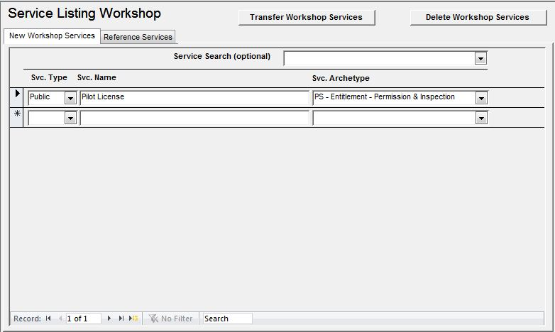
Service Definition
Notes:
<jra>Covered by Introduction tab of MRM Service definition dialog</jra>

Slide 3
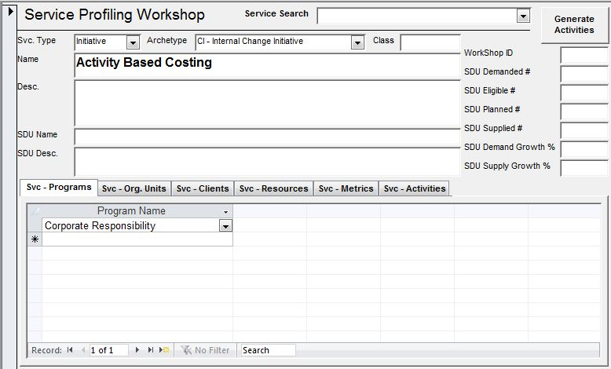
Service Profiling
Notes:
<jra>Covered by the other tabs and pages of the MRM Service definition</jra>

Slide 4
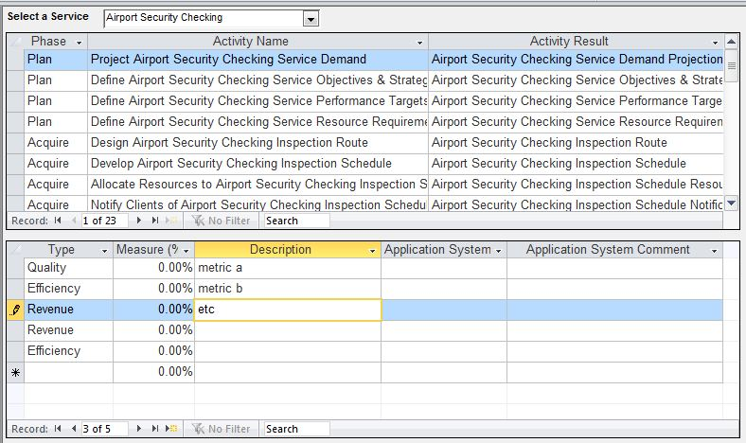
Activity – Performance Metric Mapping
Notes:
<jra>Activity → Process, Result → Output, Phase → Process Type, Measure → Performance Indicator, App, Type → Performance Indicator Type (Application System and Application System Comment are no longer used).
For a selected service:
Display a list of the processes implementing the service including the process type, description and output
For the selected process show:
List the performance indicators including performance indicator, planned and actual performance and description.
This can be handled by navigating the definitions dialogs.
Use the Explorer to choose a service
See the list of processes, select a process of interest and click Define to navigate to its definiton
See the list of Process Performance relationships (as a grid), select the KPI of interest and see its details.

Slide 5
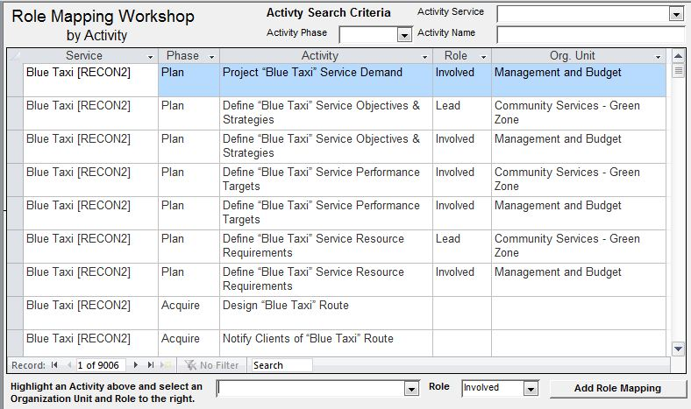
Activity – Role Mapping (1)
Notes:
<jra>Activity → Process, Phase → Process Type,
Select a service, see the processes that implement them, and their process type. Choose the organization unit and select its role type.
This can be handled by navigating the definitions dialogs.

Slide 6
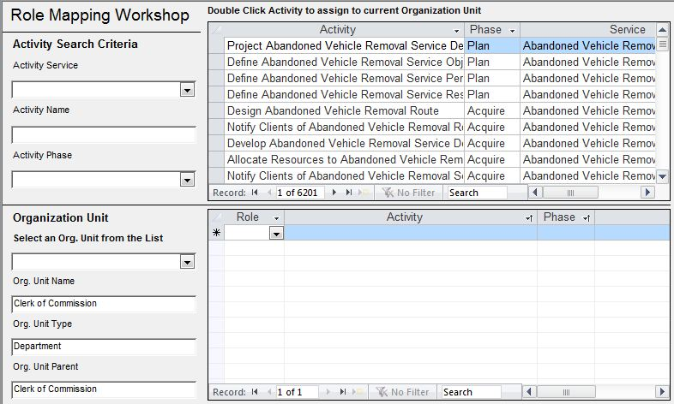
Activity – Role Mapping (2)
Notes:
<jra>This is a second version of the previous template. The previous view (1) was for interacting with a group of people. This is for a particular stakeholder/organization unit.
Similar solution as the previous template, but navigates from the Organization Unit,

Slide 7
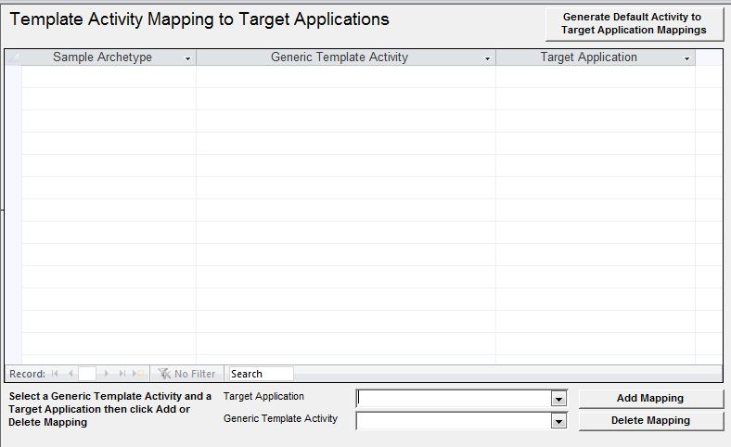
Activity - Application Mapping
Notes:
Not Applicable for MRM

